Slide 1
Comparative dynamic transcriptome analysis (cDTA) reveals mutual feedback between mRNA synthesis and degradation
Sun et al

Slide 2
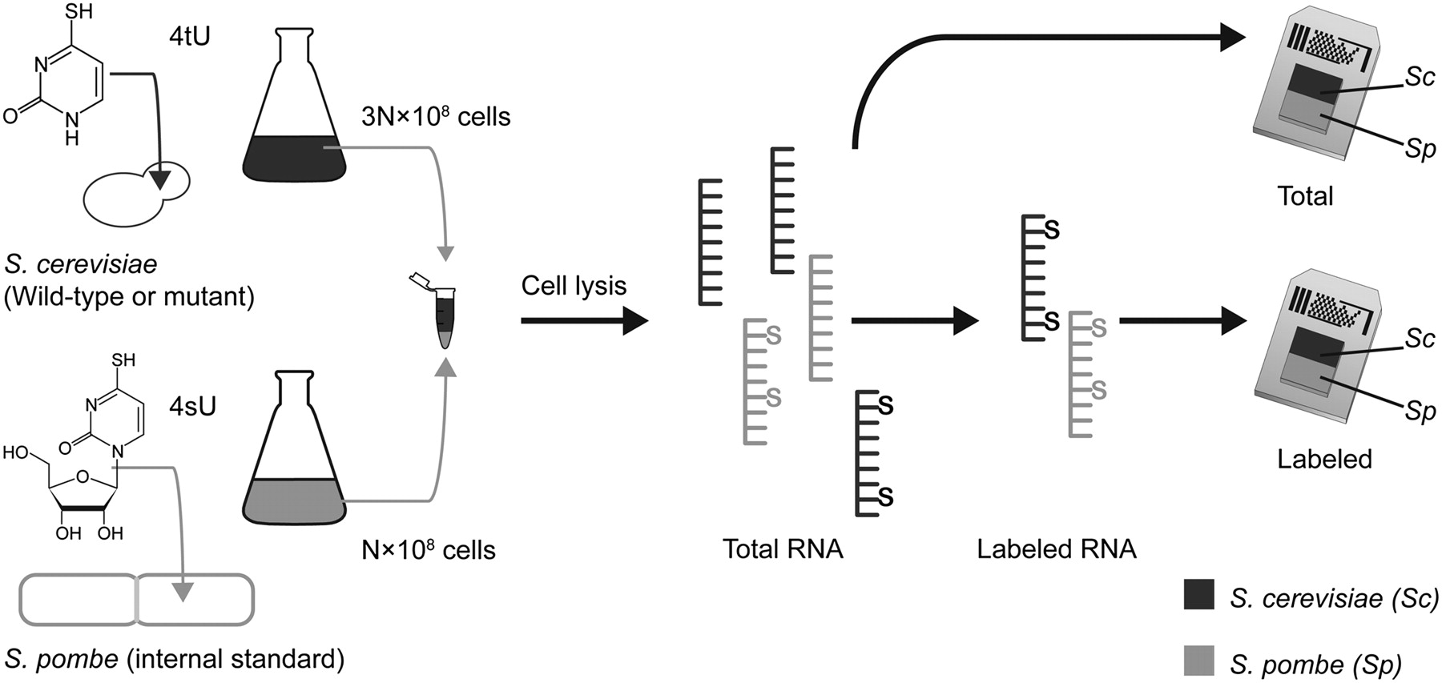
cDTA experiment methods

Slide 3
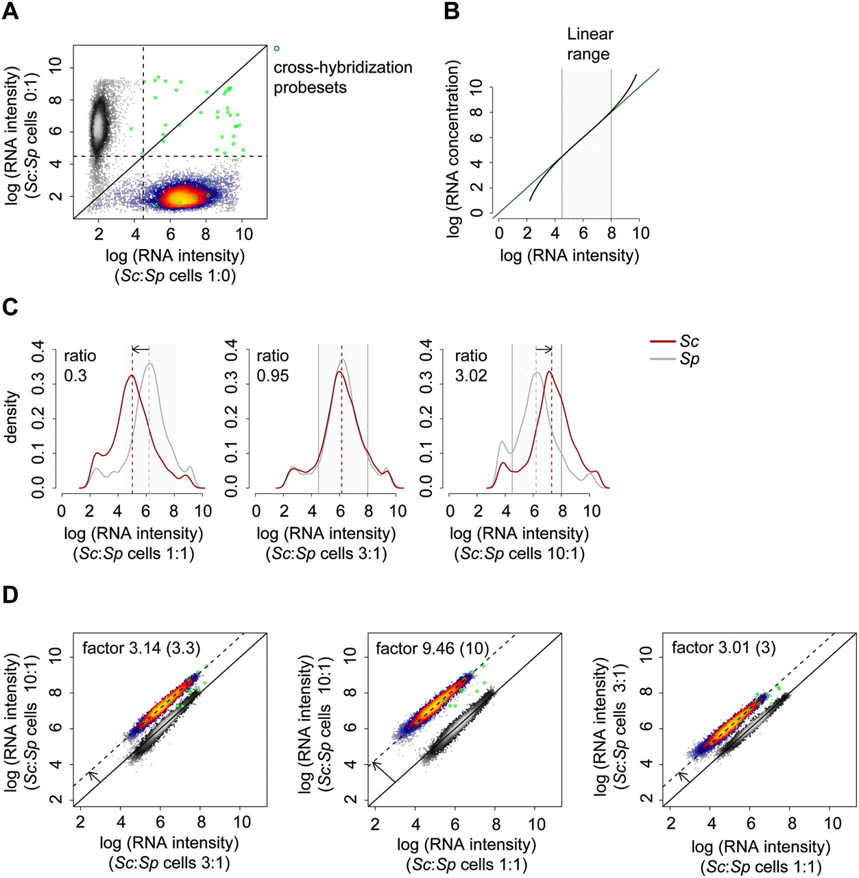
Explanation of cDTA protocol

Slide 4
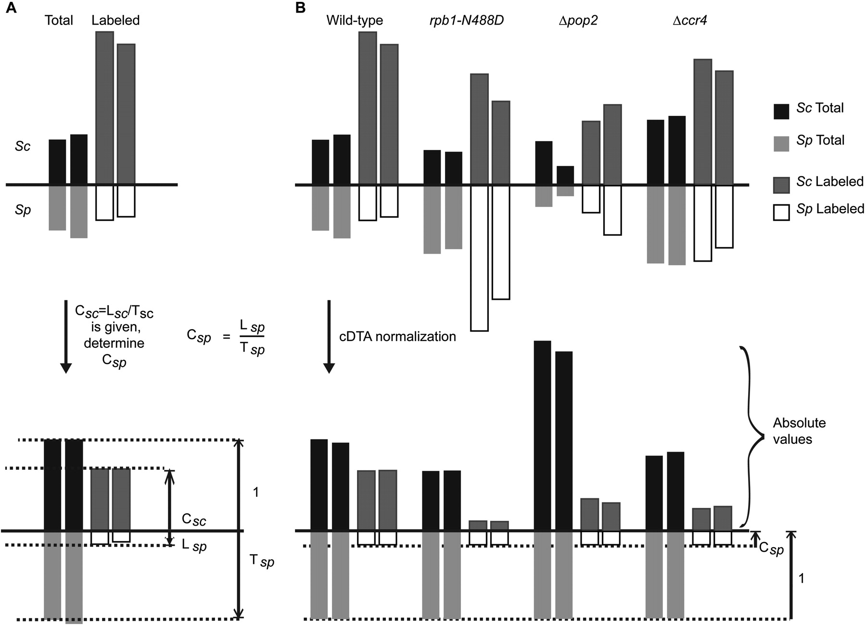
cDTA normalization for direct comparison of Sc data between different experiments allows global changes to be shown

Slide 5
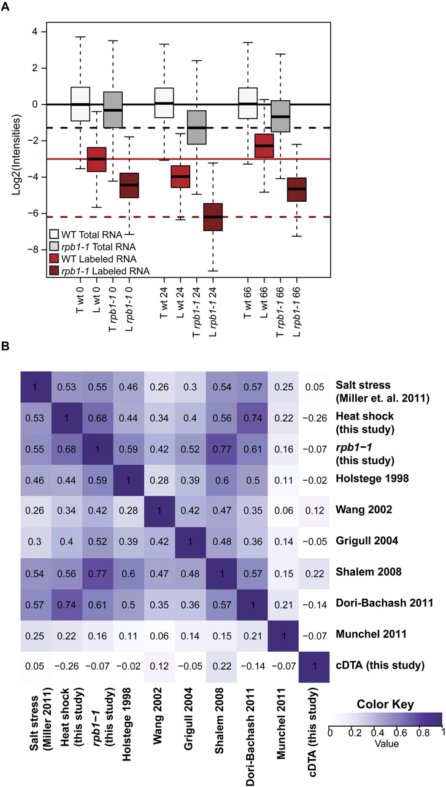
Conventional methods of mRNA half-life estimation using rphb1-1 mutant strain or transcriptional arrest do not produce reliable half-life estimations

Slide 6
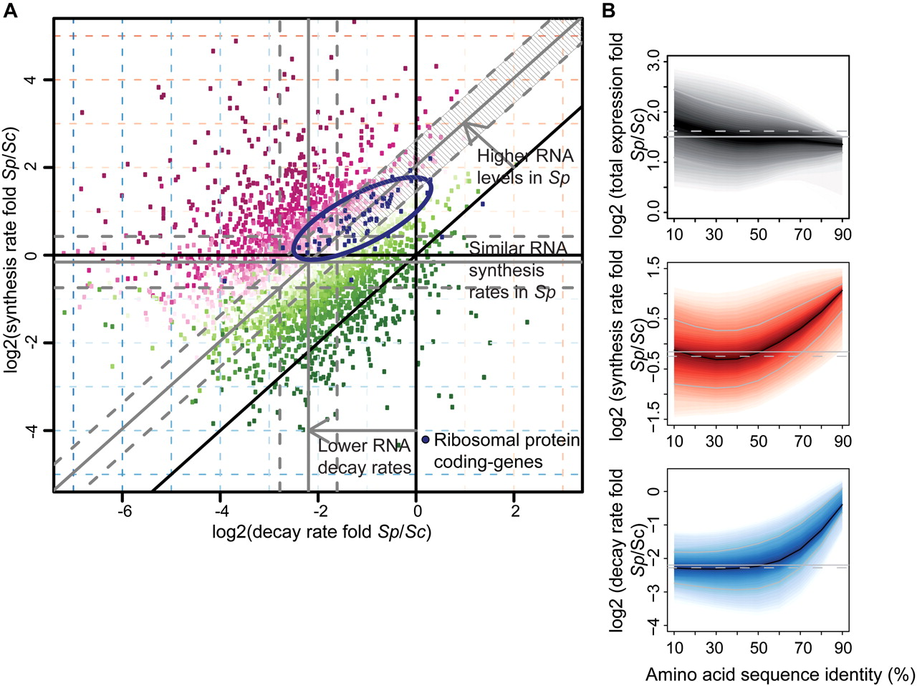
cDTA reveals differences in mRNA metabolism of Sc and Sp suggesting that Sp cells have more stable mRNAs

Slide 7
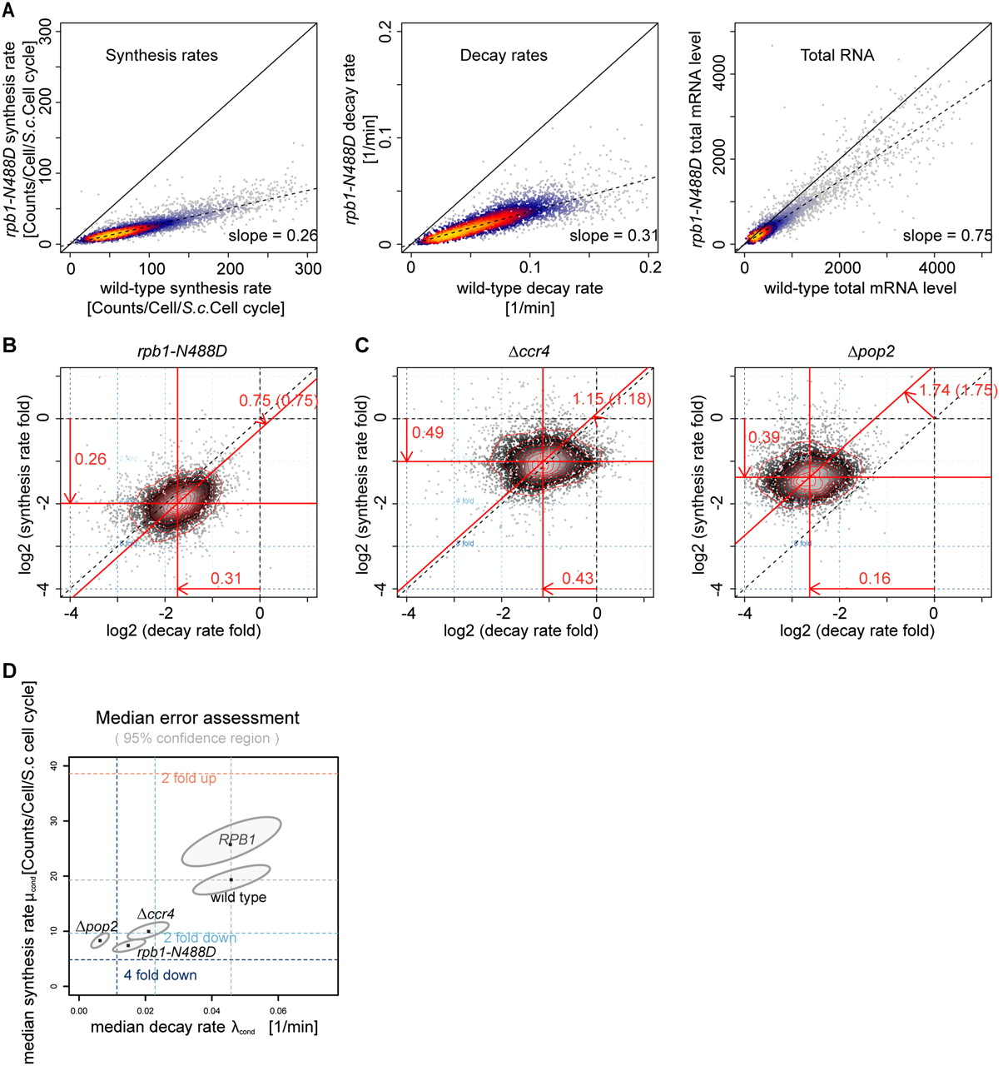
Mutant strain synthesis and decay rates show that total mRNA levels are regulated by decreased degradation when synthesis rates are lowered

Slide 8
Periodic mRNA synthesis and degradation co‐operate during cell cycle gene expression
Eser et al

Slide 9
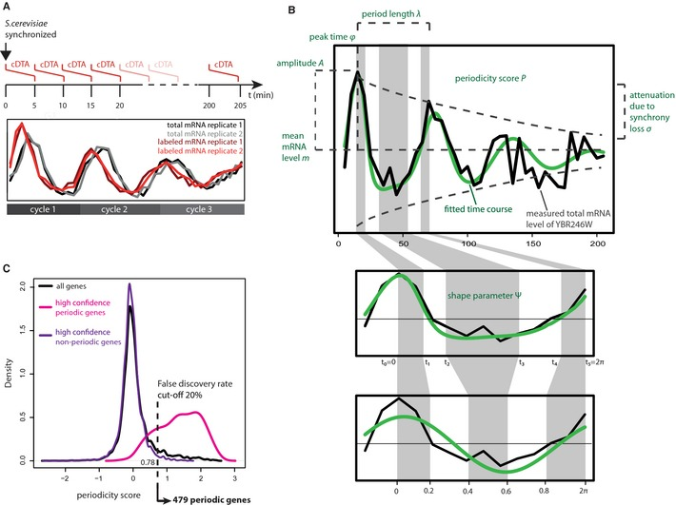
Method for identifying periodic mRNA during the cell cycle

Slide 10
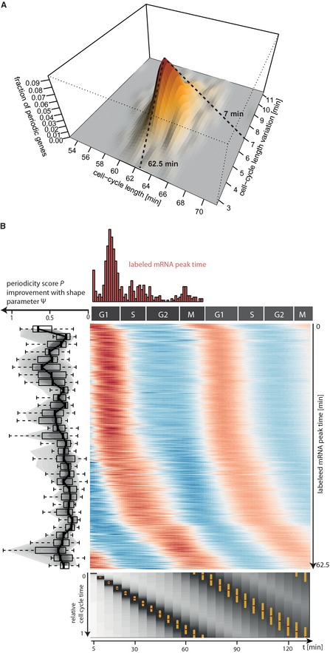
Biological profiles of the identified periodic genes

Slide 11
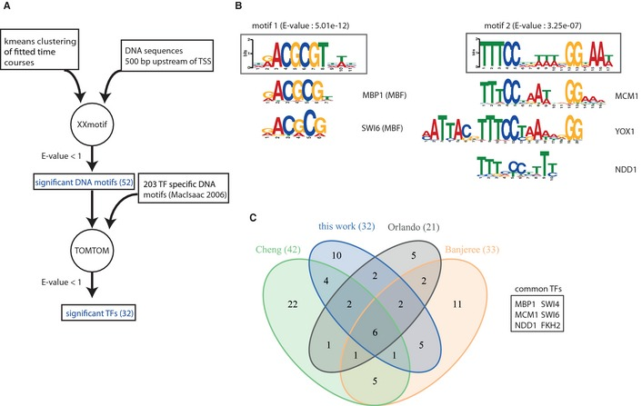
Methods for finding cell-cycle related transcription factors

Slide 12
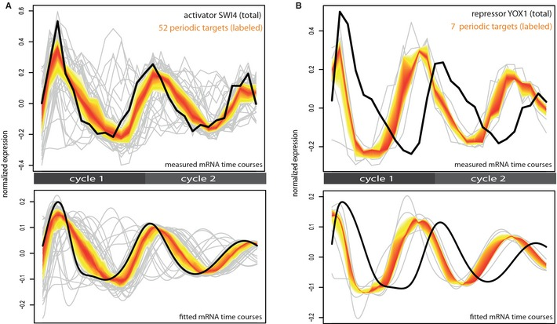
mRNA time course data for SWI4 and YOX1 and the periodically expressed target genes associated with the TFs

Slide 13
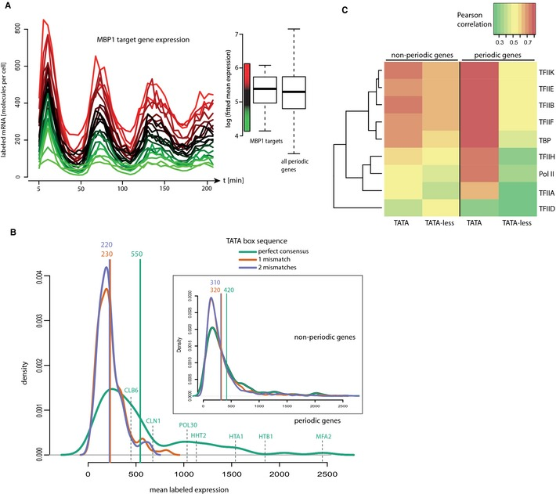
TFs control the timing of expression and core promoter sequences control mRNA synthesis

Slide 14
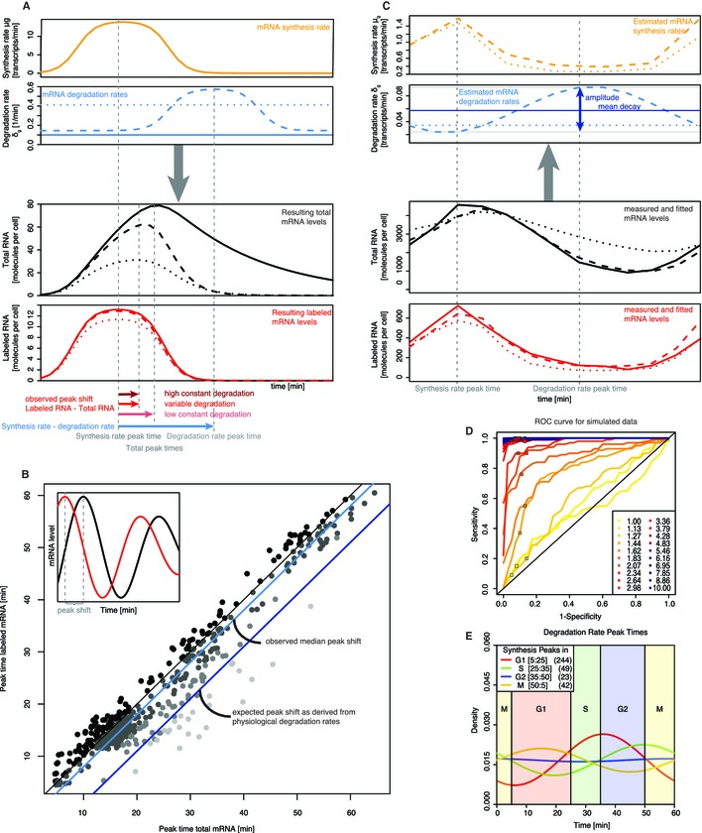
Degradation rates are non-linear and also not dictated by cell cycle phase

